Slide 1
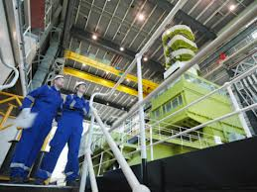
Nuclear Engineering
By: Jon Gregory

Slide 2
Definition
Nuclear engineers are primarily involved in researching and developing systems, instruments, and processes utilized for obtaining drawing benefits from nuclear radiation and energy. Most are focused on finding medical and industrial uses for radioactive materials and others are involved in developing nuclear power sources for spacecrafts and ships

Slide 3
Requirements
All entry-level engineering work positions require an Engineering bachelor’s degree, while those who graduate from Universities with degrees in math, chemistry, or physical science may be highly eligible for engineering jobs that require specific skills and requirements. The most common engineering degrees include civil, mechanical, nuclear, electronics, materials, or electrical engineering

Slide 4
Responsible for..
Nuclear engineers are responsible for:
Designing and developing nuclear equipment like radiation shields, reactor cores, and other related instruments
Evaluating nuclear-related accidents and collecting required information to develop pre-emptive measures
Supervising and keeping track of operations in nuclear facilities for confirming that operation, construction, and design methods used are in compliance with nuclear safety laws and regulations
Recording instructions to be utilized in the operating processes of nuclear facilities like nuclear waste management and disposal
Conducting experiments to determine if a nuclear facility’s methods of nuclear waste management, nuclear fuel retrieval, and nuclear material usage are up to code and acceptable

Slide 5
Salary
According to the United States Bureau nuclear engineers currently have a median yearly wage of $101,900, with the higher 10% earning over $147,600 and the lower 10% earning under $67,000

